Slide 1


UNIVERSITY COLLEGE OF ENGINEERING (BIT CAMPUS) TIRUCHIRAPPALLI
PARKINSON’S DISEASE DETECTION USING VOICE SIGNALS WITH DEEP LEARNING
PRESENTED BY
Reshma S-810022104074
Pathmapriyaa E-810022104100
GUIDED BY
Dr.S.Usha
Assistant Professor(Sl.Gr)

Slide 2
INTRODUCTION
Parkinson’s Disease is a neurological disorder that affects movement and speech.
Early symptoms often appear as changes in voice, such as reduced loudness and irregular pitch variations.
Common symptoms include tremors, rigidity, slowness of movement (bradykinesia), postural instability, and speech impairments.
Voice-based analysis is a non-invasive and cost-effective method for early detection.

Slide 3
EXISTING SYSTEM
Most existing systems use traditional machine learning models such as Support Vector Machine (SVM), K-Nearest Neighbors (KNN), and Decision Trees to detect Parkinson’s disease from voice data.
These systems depend on manual feature extraction, where features like jitter, shimmer, and pitch must be selected by the developer.
Traditional models often perform well on controlled datasets, but can struggle with noisy real-world recordings.

Slide 4
LIMITATIONS
Reliance on traditional ML models (SVM, KNN, Decision Trees) with manual feature extraction
Poor performance on real-world noisy data and varying recording conditions
Inability to capture both temporal (time) and spectral (frequency) features effectively
Lack of real-time processing for continuous monitoring
No integrated platform for end-to-end analysis (processing → prediction → reporting)
Limited user accessibility (not user-friendly or web-based)
Absence of automated risk assessment and clear result interpretation

Slide 5
OBJECTIVE
To detect Parkinson’s Disease using voice signals by analyzing speech variations and extracting features such as MFCC and related spectral features.
To apply a CNN + BiLSTM Autoencoder model to automatically learn voice patterns and identify abnormalities.
To classify individuals as normal or potentially Parkinson’s affected, thereby supporting early and non-invasive diagnosis of Parkinson’s Disease.

Slide 6
LITERATURE SURVEY
S.NO | TITLE | AUTHORS NAME | YEAR/ PUBLISHE | METHOD/ TECHNOLOGY | LIMITATIONS | FUTURE WORK
1. | Characterizing Disease Progression in Parkinson’s Disease from Videos of the Finger Tapping Test | Diego L. Guarín, Joshua K. Wong, Nikolaus R. McFarland, Adolfo Ramirez-Zamora | 2024, IEEE Transactions on (NSRE) | Developed an automated video-based assessment framework using markerless hand pose estimation (Google MediaPipe) to analyze Finger Tapping test videos from the MDSUPDRS III. | Relied on single clinician severity ratings,which may introduce subjectivity. Dataset size was limited and imbalanced | Future work includes collecting larger, balanced datasets, incorporating multiple clinician raters, and including de novo and late-stage PD patients.
2. | Early Detection of Parkinson’s Disease Using Deep NeuroEnhanceNet With Smartphone Walking Recordings | Tongyue He, Junxin Chen, Xu Xu, Giancarlo Fortino, Wei Wang | 2024, IEEE Transactions on (NSRE) | Proposed Deep Neuro Enhance Net, a CNN-based architecture with Residual Blocks, Multi-head Attention, and SE blocks | Cannot grade or assess PD severity, only performs binary early detection. | Future work includes extending analysis to severity assessment and symptom tracking, especially using rests tage data.
3. | Detection of Early Parkinson’s Disease by Leveraging Speech Foundation Models | Quang Dao, Laetitia Jeancolas, Graziella Mangone, Sara Sambin, Alizé Chalançon, | 2025, IEEE (JBHI), | Investigated three speech foundation models— wav2vec2.0, Whisper, and SeamlessM4T—for early PD detection using voice recordings | Dataset focuses mainly on early-stage PD. Gender imbalance affects performance, with lower accuracy for females. | Future work includes adapting models to noisier real world conditions (telephone and home recordings) using noise robust
4. | Multimodal Deep Learning Framework for Customizable and Interpretable Parkinson’s Disease Detection | Mitesh Kothari, Ganeshan Arumuganain ar, Kaliraj Konar | 2025 / Preprint – Industry Research | Proposed a multimodal ML & DL framework integrating Voice (Random Forest), Handwriting Signals (XGBoost), (ResNet-18), Gait VGRF (Transformer Encoder), and Non-Motor Symptoms (Random Forest). | Relatively small dataset sizes for somemodalities (voice, handwriting), increasing overfitting risk. Data collected in controlled clinical settings, limiting realworld robustness. | Use of AlphaFoldbased protein structure prediction to link genotype with phenotype.

Slide 7
S.No | TITLE | AUTHORS NAME | YEAR/ PUBLISHE | METHOD/ TECHNOLOGY | LIMITATIONS | FUTURE WORK
1. | Early Diagnosis of Parkinson’s Disease Using Machine Learning Algorithms | Z.K. Senturk | 2020, Medical Hypotheses | Support Vector Machine (SVM), Feature Selection | Requires manual feature selection; limited scalability | Automate feature extraction using deep learning
2. | Investigating Voice as a Biomarker for Early Detection of Parkinson’s Disease | J.M. Tracy et al | 2020, Journal of Biomedical Informatics | Logistic Regression, Random Forest, Gradient Boosting | Limited deep learning exploration; feature dependency | Integrate CNN-LSTM hybrid models; multimodal biomarker analysis
3. | Parkinson’s Disease Detection Based on Spectrogram-DCGAN | Z.J. Xu et al | 2020, IEEE Access | Spectrogram images, ResNet50, GAN-based data augmentation | Small dataset; computational complexity | Use larger datasets; optimize GAN stability; real-time implementation
4. | ResNet-Based Parkinson’s Disease Classification | Omar El Ariss, Kaoning Hu | 2023, IEEE Transactions on Artificial Intelligence | ResNet50, Transfer Learning, Heat Map Conversion of TQWT, DWT, MFCC features | Limited to single dataset (Sakar dataset); class imbalance; only speech modality | Combine multiple feature sets; explore multimodal frameworks; investigate impact of color encoding

Slide 8
PROPOSED SYSTEM
The proposed system uses a deep learning approach to detect Parkinson’s Disease from voice signals.
Voice recordings are preprocessed, and important features such as MFCC are extracted for analysis.
A CNN model learns spectral and frequency-based patterns from the voice data.
A BiLSTM Autoencoder captures temporal variations and detects abnormalities using reconstruction error.
The system classifies voice samples as normal or potentially Parkinson’s affected, supporting early and non-invasive diagnosis.

Slide 9
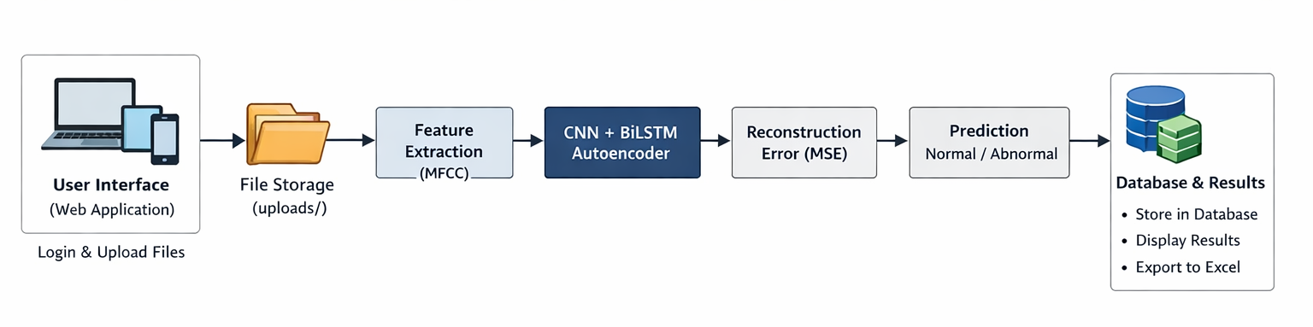
SYSTEM ARCHITECTURE

Slide 10
METHODS AND TECHNIQUES
Voice Data Collection
Collect voice recordings from individuals (normal and Parkinson’s affected).
Use short speech samples for analysis.
Preprocessing
Normalize the audio signal for consistent amplitude levels.
Remove silence and unwanted segments before feature extraction.
Feature Extraction
Extract MFCC features from the preprocessed voice signals.
Convert voice signals into a structured feature representation suitable for deep learning analysis.

Slide 11
Model Training
Train a CNN + BiLSTM Autoencoder model using the extracted features.
Use CNN to learn spectral and frequency-based patterns.
Use BiLSTM to capture temporal and sequential variations in speech.
Classification
Detect abnormalities using reconstruction error and classify voice samples as normal or potentially Parkinson’s affected.

Slide 12
MODULES
User Authentication & Session Management
Voice Input & Preprocessing
CNN + BiLSTM Autoencoder
Classification & Risk Stratification
Web Interface & Reporting

Slide 13
SOFTWARE REQUIREMENTS
Operating System | Windows 10 / 11 or Linux
Programming Language | Python 3.8 or higher
Development Environment | Jupyter Notebook / VS Code / PyCharm
Libraries & Frameworks | NumPy,Pandas,Librosa (voice processing) TensorFlow / Keras (CNN, BiLSTM),scikit-learn(evaluation metrics)Matplotlib (visualization)
Dataset | Parkinson’s voice dataset (WAV audio files)
COMPONENT
SPECIFICATION

Slide 14

HARDWARE REQUIREMENTS
Processor | Intel i5 or higher (or equivalent)
RAM | Minimum 8 GB (16 GB recommended)
Storage | 10–20 GB free space
COMPONENT
SPECIFICATION

Slide 15
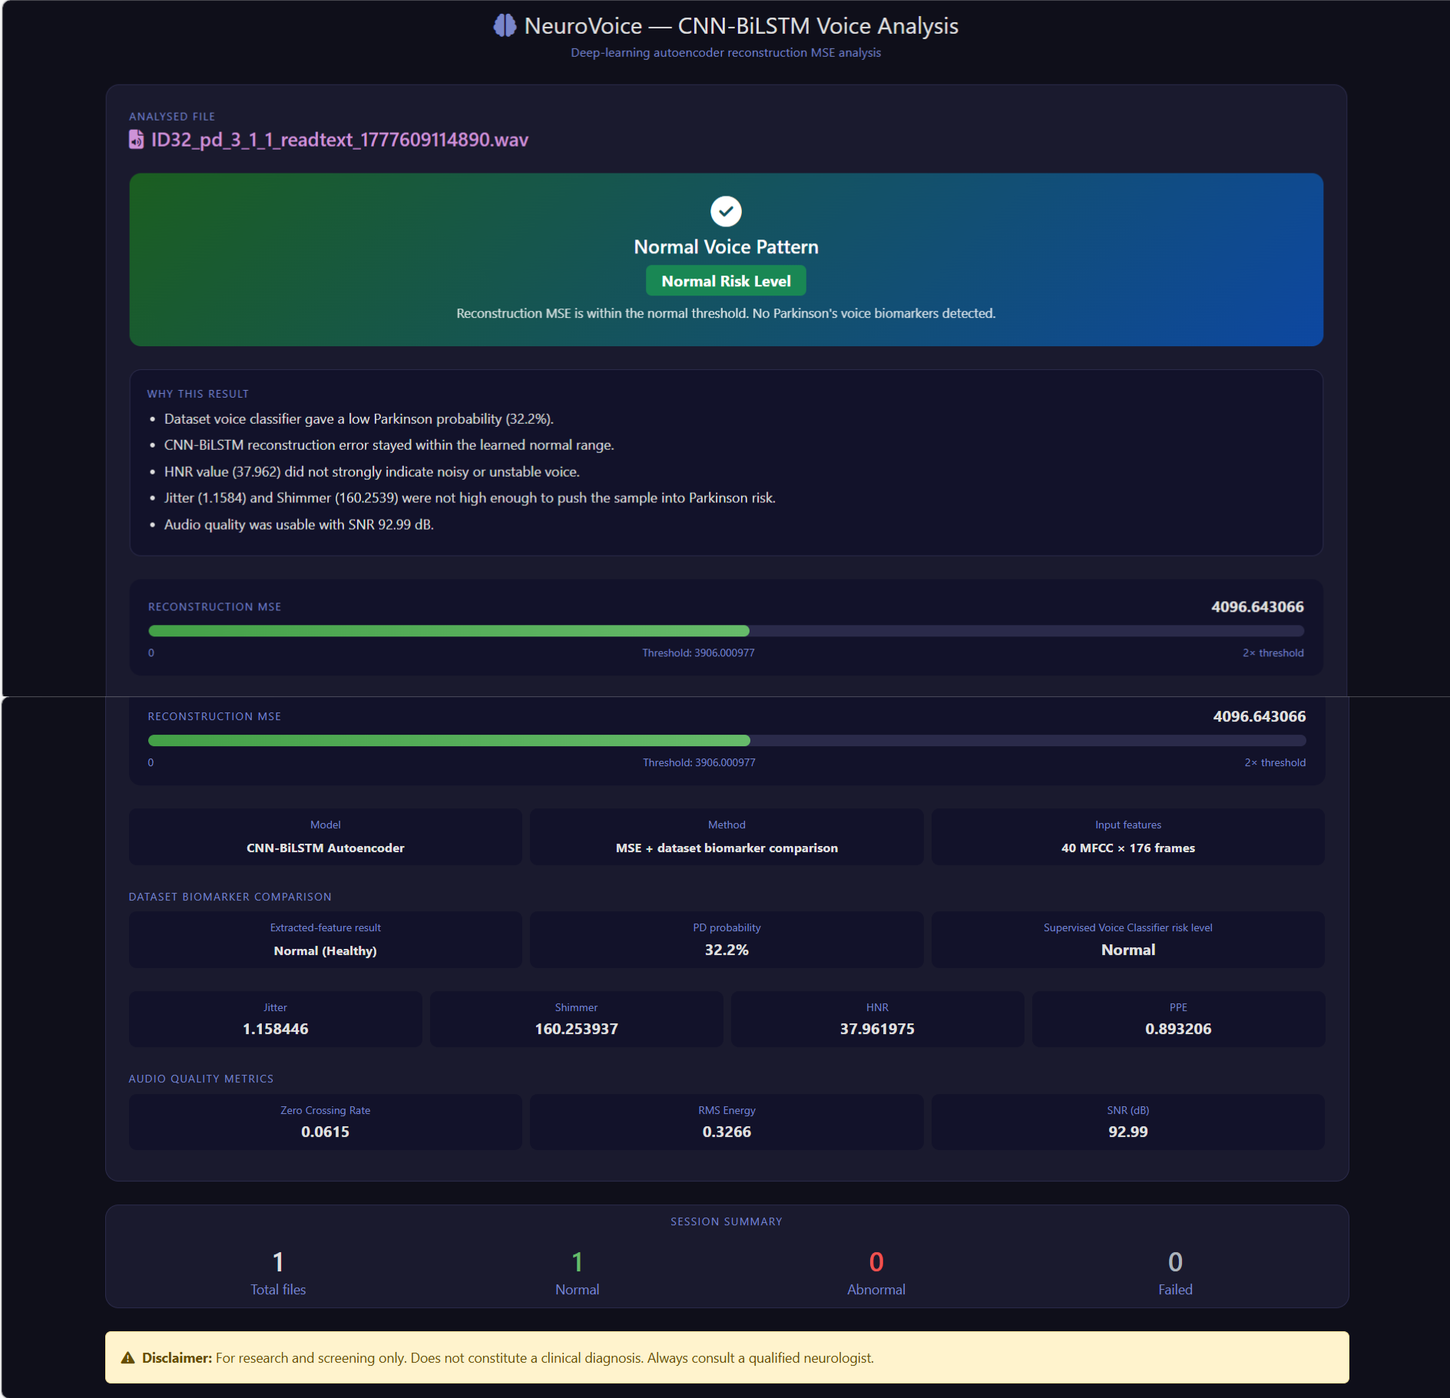
OUTPUT

Slide 16
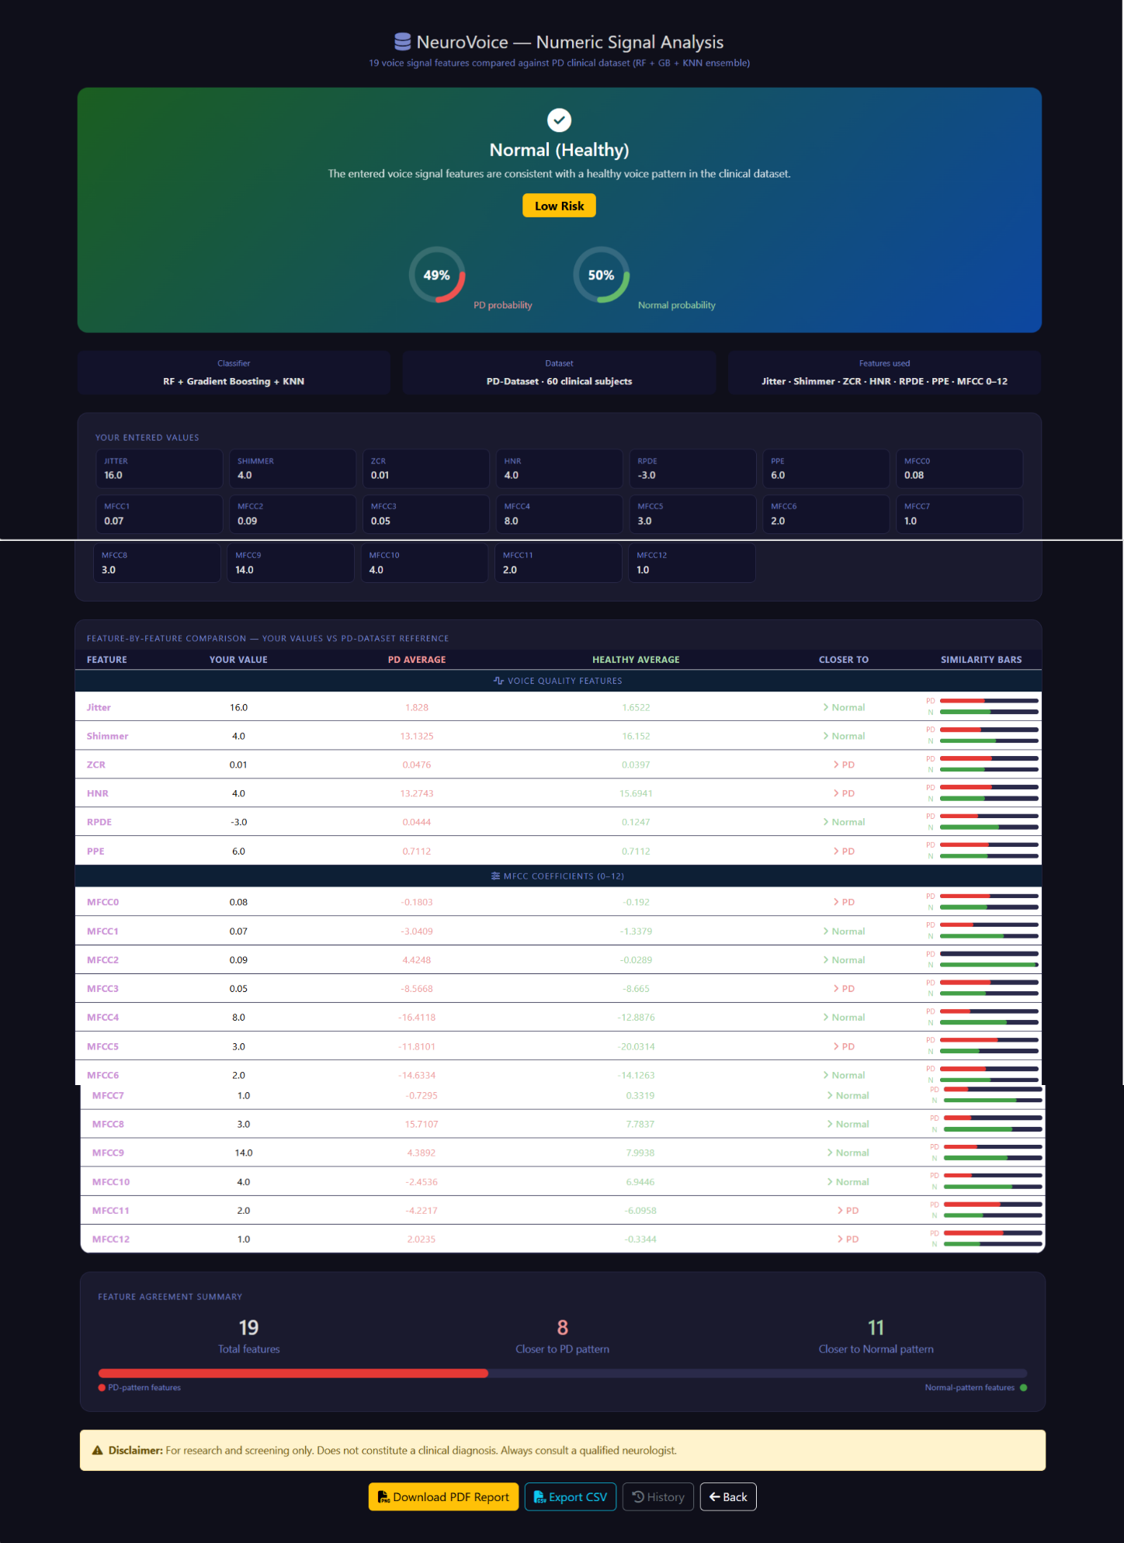
OUTPUT

Slide 17
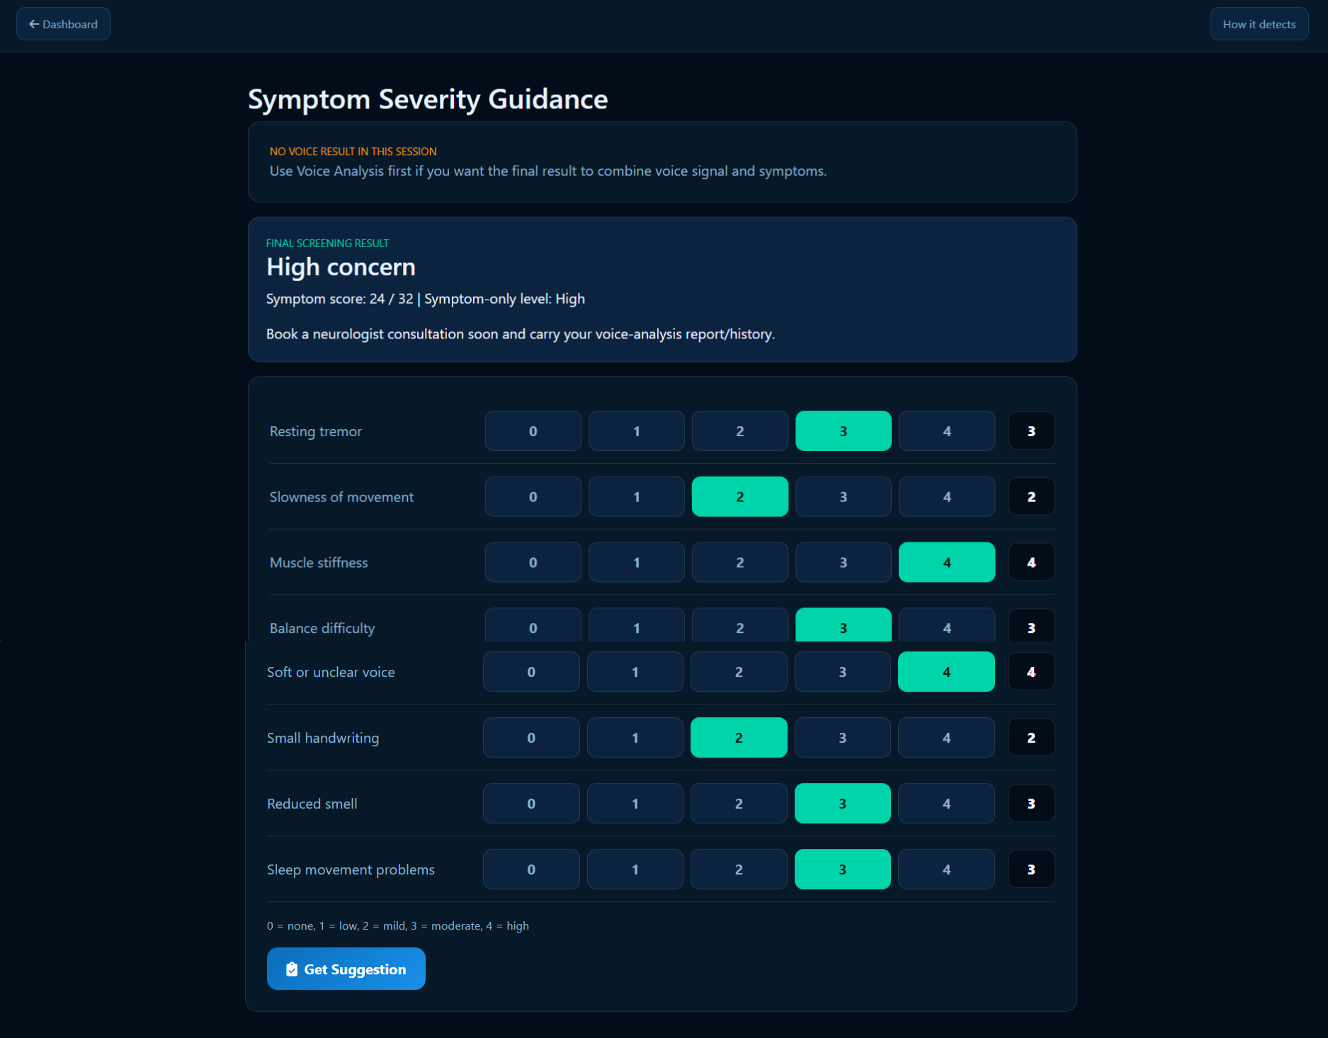
OUTPUT

Slide 18
OUTCOMES
The proposed Parkinson’s Disease Detection using Voice system successfully analyzes uploaded .wav audio samples and predicts whether the subject shows signs of Parkinson’s disease.
After uploading the voice sample:
The system preprocesses the audio and extracts relevant acoustic features.
The trained CNN + BiLSTM Autoencoder model computes the reconstruction error.
The reconstruction error is compared with a predefined threshold value.
If the error exceeds the threshold, the system classifies the sample as Parkinson Detected.
If the error is below the threshold, the system classifies the sample as Healthy.

Slide 19
CONCLUSION
In conclusion, this project successfully demonstrates a deep learning–based approach for detecting Parkinson’s Disease using voice signals.
By extracting MFCC features and applying a CNN + BiLSTM Autoencoder model, the system effectively identifies speech abnormalities associated with the disease.
The proposed method offers a non-invasive, efficient, and reliable solution for early screening and has the potential to be further improved with larger and more diverse datasets.

Slide 20
.
REFERENCES
[1] M. Gilat et al., “A systematic review on exercise and training-based interventions for freezing of gait in Parkinson’s disease,” npj Parkinson’s Disease, vol. 7, no. 1, pp. 1–18, Sep. 2021.
[2] E. Tolosa, A. Garrido, S. Scholz, and W. Poewe, “Challenges in the diagnosis of Parkinson’s disease,” Lancet Neurol., vol. 20, no. 5,pp. 385–397, 2021.
[3] Y. Yang et al., “Artificial intelligence-enabled detection and assessment of Parkinson’s disease using nocturnal breathing signals,” Nature Med., vol. 28, no. 10, pp. 2207–2215, Oct. 2022

Slide 21
[4] L. Sigcha et al., “Improvement of performance in freezing of gait detection in Parkinson’s disease using transformer networks and a single Waist–Worn triaxial accelerometer,” Eng. Appl. Artif. Intell., vol. 116, Nov. 2022, Art. no. 105482.
[5] L. Pepa, M. Capecci, E. Andrenelli, L. Ciabattoni, L. Spalazzi, and M. G. Ceravolo, “A fuzzy logic system for the home assessment of freezing of gait in subjects with Parkinsons disease,” Expert Syst. Appl., vol. 147, Jun. 2020, Art. no. 113197.
[6] R. Ou et al., “Freezing of gait in Parkinson’s disease with glucocerebrosidase mutations: Prevalence, clinical correlates and effect on qualityof life,” Frontiers Neurosci., vol. 17, Nov. 2023, Art. no. 1288631

Slide 22
THANK YOU

